Slide 1



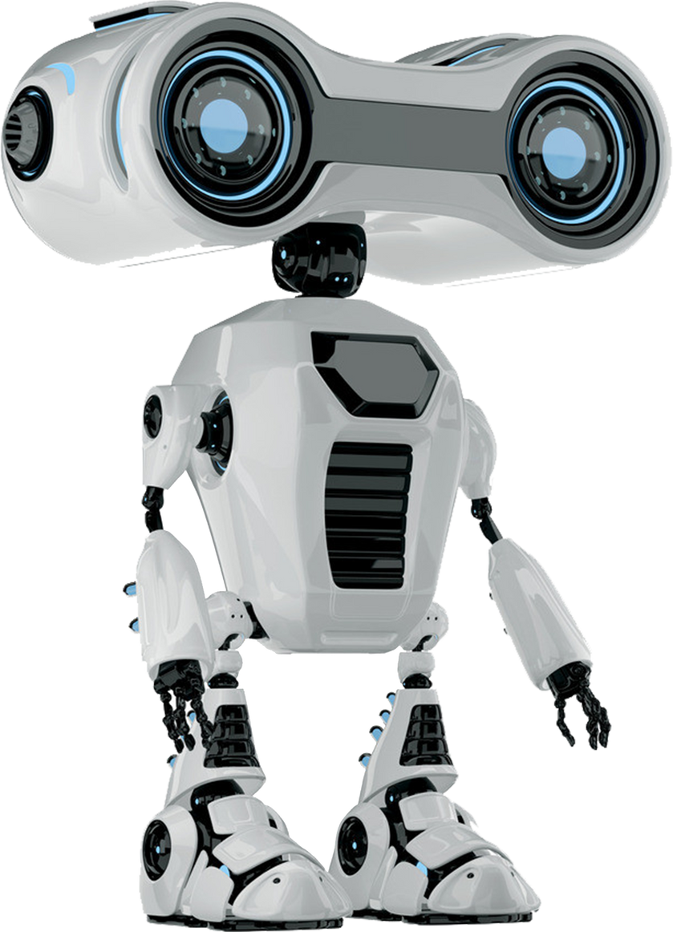
OBJECT DETECTION USING OPENCV WITH ROS2 AND TURTLEBOT4

Slide 2
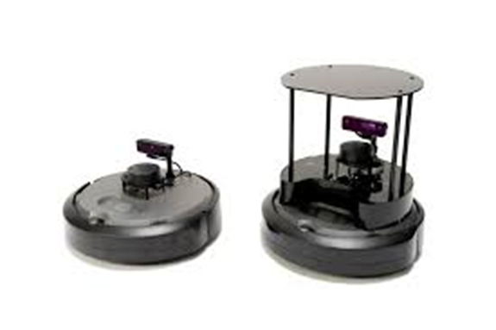
INTRODUCTION
This project explores the integration of real-time object detection into a mobile robot system.
Utilized ROS2 Humble, OpenCV, and YOLOv8 to achieve perception tasks.
Platform used: TurtleBot4 with integrated RGB-D camera and LiDAR. Rviz for vizualization.
Application: Indoor robotic navigation and intelligent decision-making in dynamic environments.

Slide 3
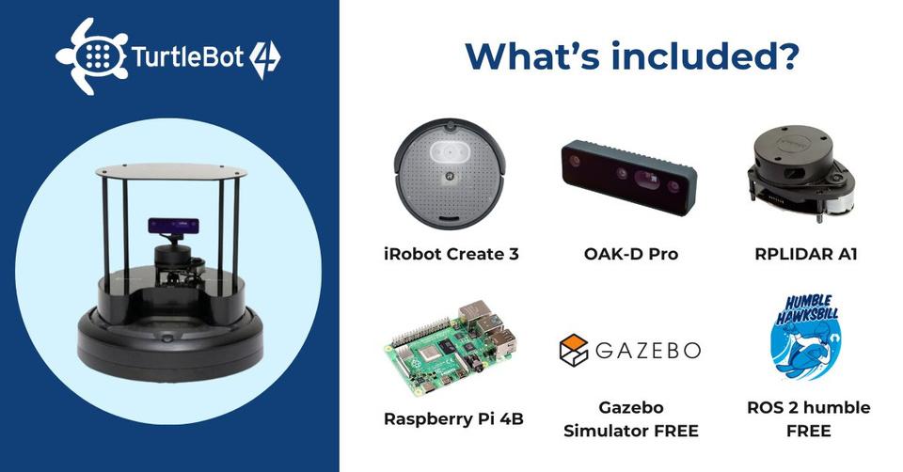
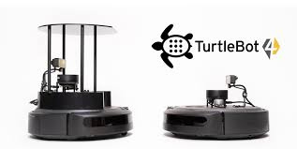
PROBLEM STATEMENT
Mobile robots often lack robust perception in dynamic indoor environments.
Real-time detection of obstacles and semantic objects is critical.
Manual control or basic obstacle avoidance is inefficient.
Our goal: Enable a robot to autonomously navigate and identify objects like people, furniture, and devices.

Slide 4
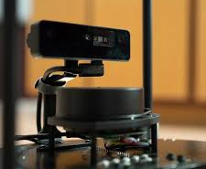
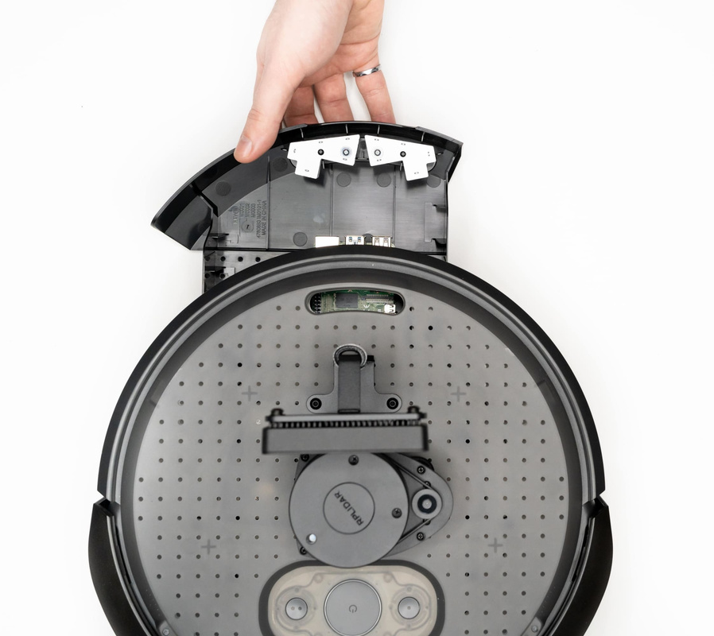
OBJECTIVES
Deploy a real-time object detection pipeline on TurtleBot4 using YOLOv8 and OpenCV.
Integrate the detection results with ROS2 navigation and SLAM for autonomous movement.
Create a reliable system for detecting multiple classes of objects in real-world environment.

Slide 5
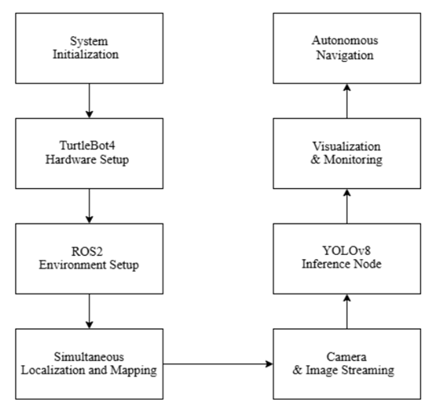
BORCELLE
Home
Service
About Us
Contact
SYSTEM ARCHITECTURE
Hardware: TurtleBot4, LiDAR, RGB-D Camera, onboard compute (Raspberry Pi 4).
Software Stack:
ROS2 Humble middleware
OpenCV for image processing
YOLOv8 for object detection
RViz2 and Foxglove Studio for visualization
ROS2 Nodes:
Camera publisher
Detection processor (Python Node)
Navigation stack (Nav2)

Slide 6
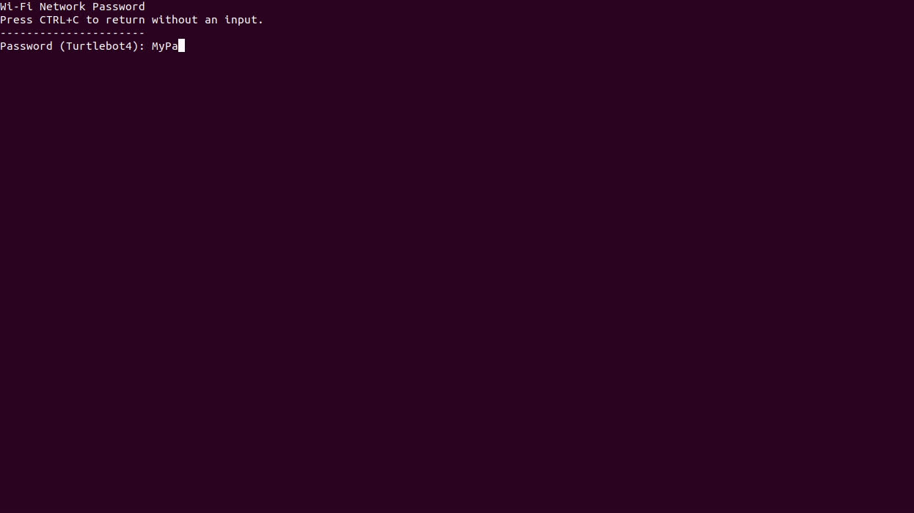
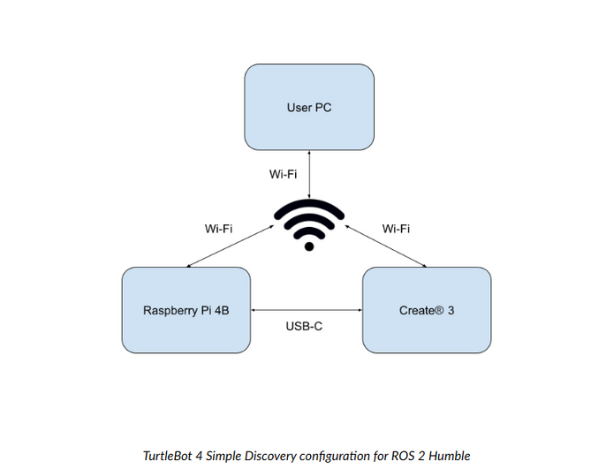
WIFI SETUP
TurtleBot4 comes with a default hotspot:
SSID = TurtleBot4-XXXX
On your computer, connect to the TurtleBot4 hotspot via Wi-Fi settings.
Once connected, open a terminal and use:
ssh ubuntu@turtlebot4.local
Password is usually ubuntu
This enables direct communication without needing additional Wi-Fi configuration.

Slide 7
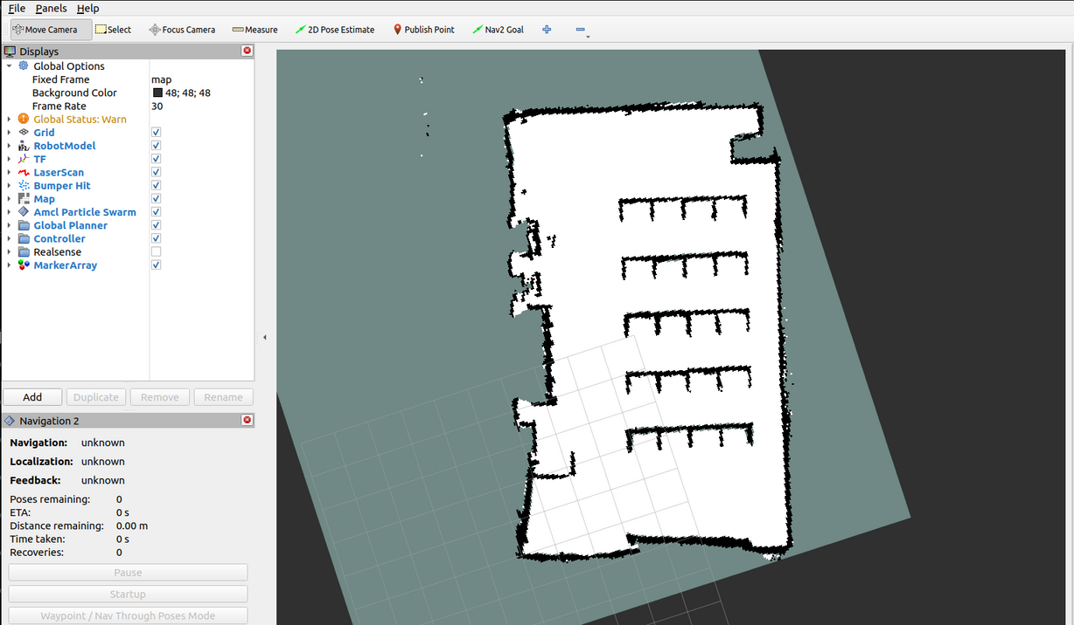
NAVIGATION STACK SETUP
Installed turtlebot4_navigation and nav2_bringup packages.
Performed initial mapping using slam_toolbox in synchronous mode.
Saved map using ros2 run nav2_map_server map_saver_cli.
Launch navigation with:
ros2 launch turtlebot4_navigation navigation.launch.py map:=/path/to/map.yaml
Used RViz2 to set goals and observe real-time path planning.
Detection topics influence path re-evaluation for dynamic obstacle avoidance.

Slide 8
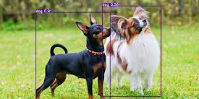
DATASET AND MODEL TRAINING
Data Collection: Captured RGB images of the lab environment.
Classes: Over 60 general and lab-specific indoor objects (e.g., laptops, chairs, 3D printers, markers, bottles, bags).
Annotation Tool: LabelImg and Roboflow.
Model Training:
Framework: Ultralytics YOLOv8 (Nano variant for performance) and CUSTOM data
Epochs: 100
Batch Size: 16
Optimizer: AdamW
Evaluation: mAP@0.5 = ~92%

Slide 9
DATASET AND MODEL TRAINING
Key Components:
Libraries Used: rclpy, sensor_msgs.msg.Image, ultralytics.YOLO, numpy, OpenCV
Model: YOLOv8n.pt – optimized for speed (~10 FPS on Raspberry Pi 4)
Subscribed Topic: /oakd/rgb/preview/image_raw – camera feed
Filtered Detection: Only detects objects from predefined allowed class list with known physical widths
Workflow:
Image Conversion: Converts ROS2 image messages to OpenCV BGR frames.
YOLOv8 Inference: Performs prediction with confidence > 0.5.
Class Filtering: Matches detected labels with allowed classes (e.g., chair, bag, laptop, person).
Visualization: Draws bounding boxes and confidence scores using cv2.rectangle() and cv2.putText().
Logging: Detected class and coordinates logged to console.

Slide 10
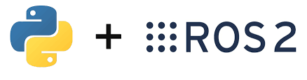
IMPLEMENTATION IN ROS2
Used CV Bridge to convert ROS image messages to OpenCV format.
Processed frames through YOLOv8 model.
Published detected objects to a custom ROS2 topic.
Integrated detections into Nav2 behavior tree for basic obstacle reasoning.
SLAM Toolbox used to create map of the lab environment.

Slide 11
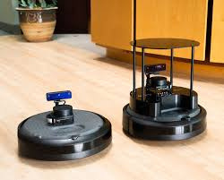
CHALLENGES AND SOLUTIONS
Latency in inference: Solved by using YOLOv8n variant.
Lighting variability: Augmented dataset with brightness/contrast changes.
Camera calibration issues: Used ROS2 camera_info_manager to fix intrinsics.
Integration with Nav2: Resolved with behavior tree customization.

Slide 12
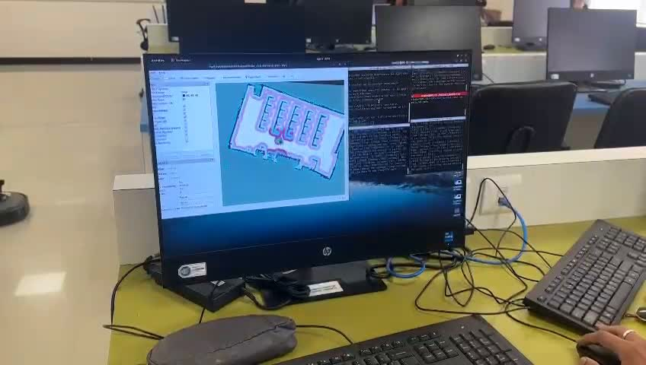
RESULTS
Demonstration Video

Slide 13
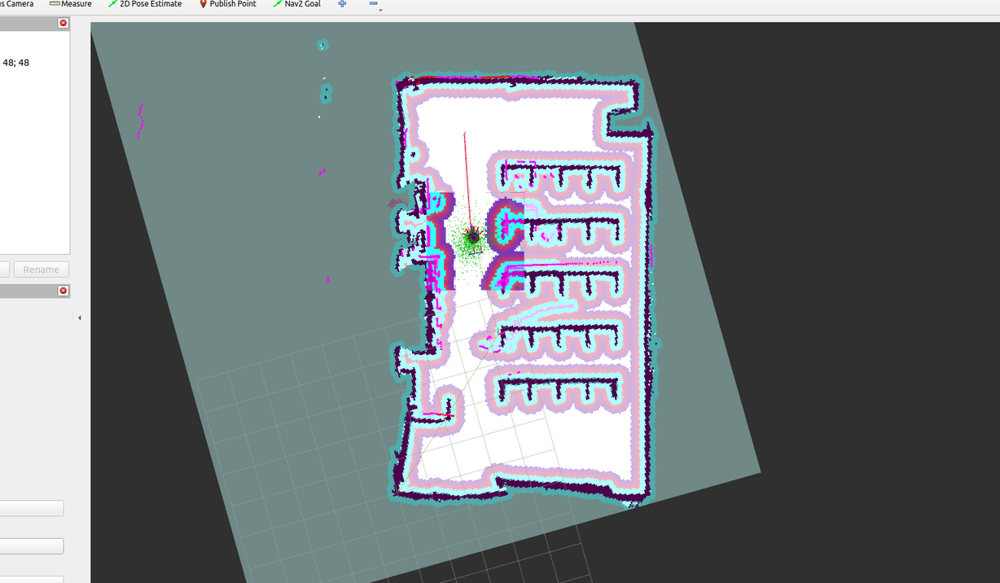
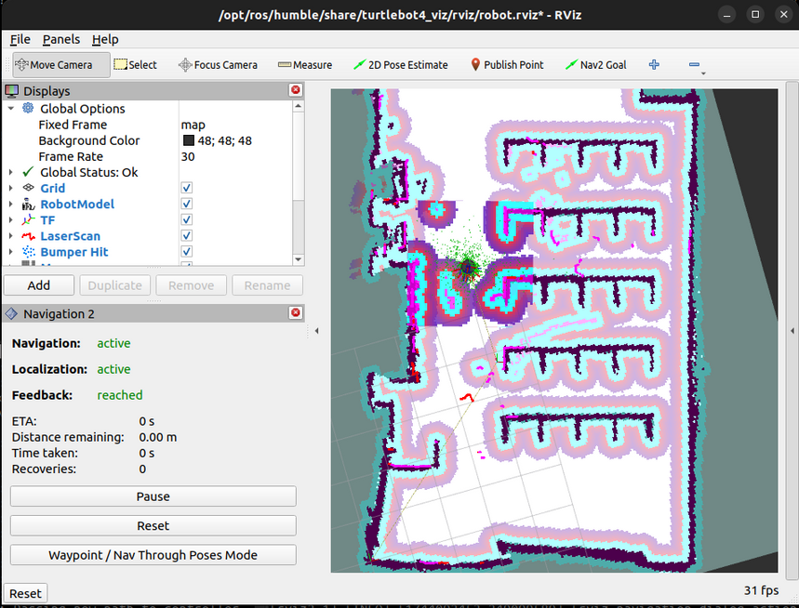
RESULTS
FIG 1 : Real time vizualization of robot in the environment.

Slide 14
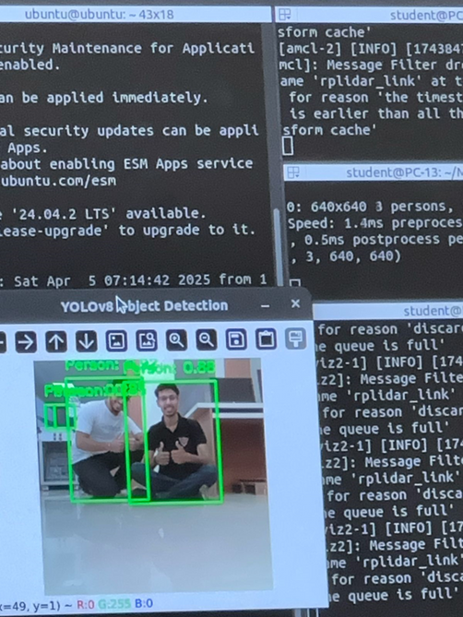
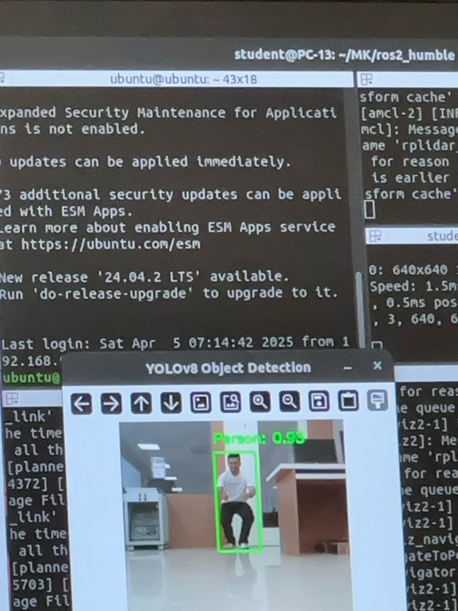
CONCLUSION
Successfully built an intelligent perception system using ROS2 and TurtleBot4.
Real-time object detection and SLAM integration achieved.
Future Directions:
Deploy object tracking (Deep SORT or ByteTrack).
Run model inference on edge AI hardware (e.g., Jetson Xavier).
Improve semantic reasoning for navigation.

Slide 15
THANK YOU
PRESENTED BY
SUBMITTED TO
Dr. Manoj Kumar Shukla
Professor
Department of Robotics and Automation
Gunjay Suhalka (22070127022)
Manan Khatri (22070127034)
Sahran Altaf (22070127059)
Yash Golani (22070127072)

